Slide 1
VOXTRACE AI
01 / SIGNAL
VOICE → ATTRIBUTES → COMPOSITE → RECORD
VOXTRACE
AI
· FACE SKETCH · CASE RECORD
Witness voice or text becomes editable visual clues and a traceable case record.
Hackathon prototype · AI face sketch with human review

Slide 2
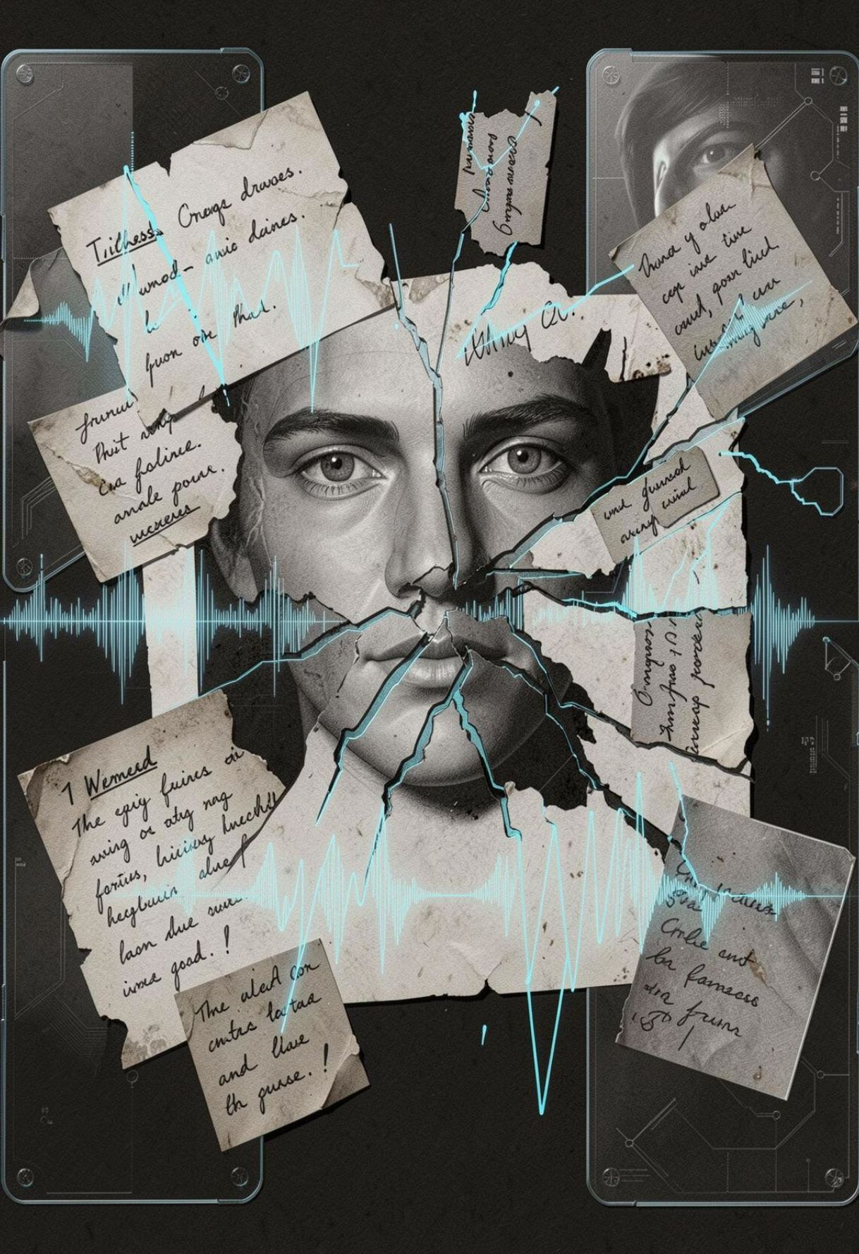
02 / PROBLEM
WITNESS MEMORY IS FRAGMENTED, AND DETAIL IS LOST BY HAND
Fragmented memory. Witnesses recall pieces, not the full scene.
Hard descriptions. Faces, places and objects must be turned into visuals by hand.
Lost uncertainty. Doubts and revisions disappear between the account, the sketches and the notes.

Slide 3
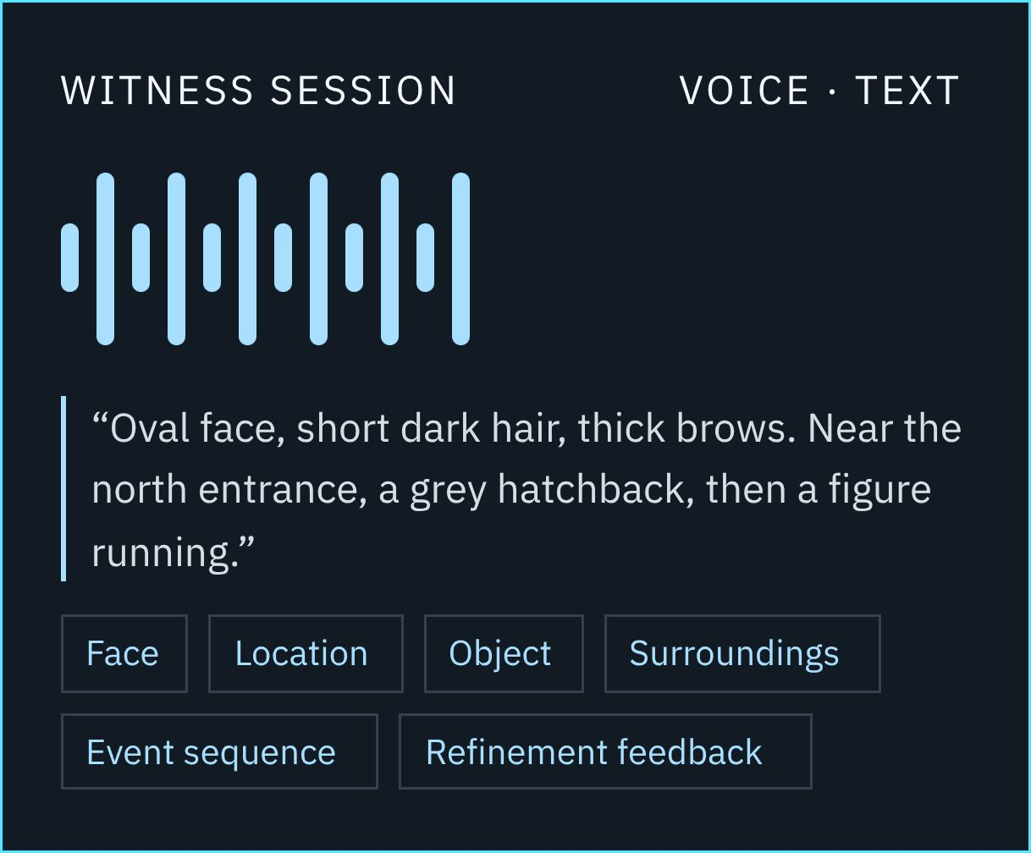
03 / WITNESS INPUT
WITNESS WORDS BECOME AN EDITABLE FACE SKETCH
Current prototype scope: input, attributes, sketch, feedback, export.
Voice or text input
Structured attributes: face, place, objects
Editable facial composite
Witness feedback
Revised version, logged
Export: sketch image and case summary

Slide 4
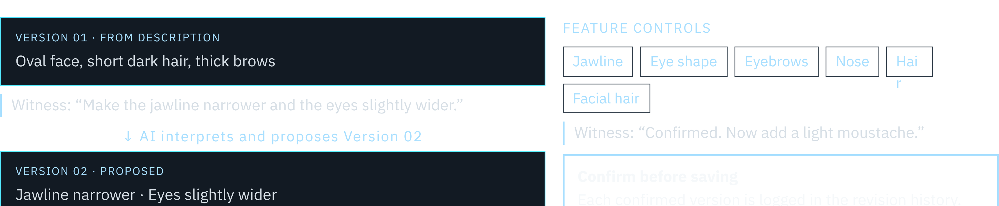
04 / FACE REFINEMENT
WITNESS FEEDBACK REFINES THE FACE BEFORE ANYTHING IS SAVED
Human review stays in the loop: the witness confirms every version.

Slide 5
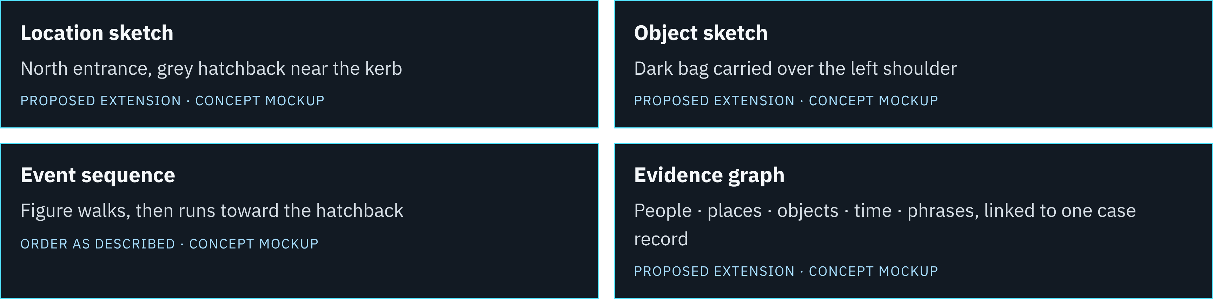
05 / BEYOND THE FACE
BEYOND THE FACE: SCENE, OBJECT AND EVENT LINKS ARE PROPOSED EXTENSIONS
Concept mockups only. Not part of the current prototype.

Slide 6
07 / FEASIBILITY AND RESPONSIBLE AI
A REALISTIC PROTOTYPE, WITH CLEAR LIMITS AND HUMAN REVIEW
Current prototype scope
Responsible AI
Browser voice and text input, Flask backend
Rule-based NLP or spaCy; SVG facial assets
JSON or SQLite revision log
Browser PDF/print export
Privacy: sensitive data handled securely
Uncertainty labels on every visual
Non-leading questions to witnesses
Human review before any use
Planned extensions
No custom-trained model, automatic suspect identification, guilt prediction, accuracy result, deployment or validation claim.
Scene and object sketches, event reconstruction, evidence graph.

Slide 7
08 / CLOSING
VOXTRACE AI TURNS WITNESS FEEDBACK INTO A TRACEABLE FACE SKETCH
A preliminary investigation aid: it supports human judgment, not proof or guilt.
VOICE OR TEXT
VISUAL CLUE
HUMAN REFINEMENT
CONNECTED CASE RECORD
Every version stays traceable, and a human reviews every step.

